Slide 1

Input / Output
Scanner class
Produced
by:
Dr. Siobhán Drohan
Ms. Mairead Meagher
Department of Computing and Mathematics
http://www.setu.ie/

Slide 2
Input in Java: the Scanner Class
The Scanner class comes with Java.
It allows us to take in data from the console / terminal window.
It is part of the java.util package in the Java Application Programming Interfaces (API).

Slide 3
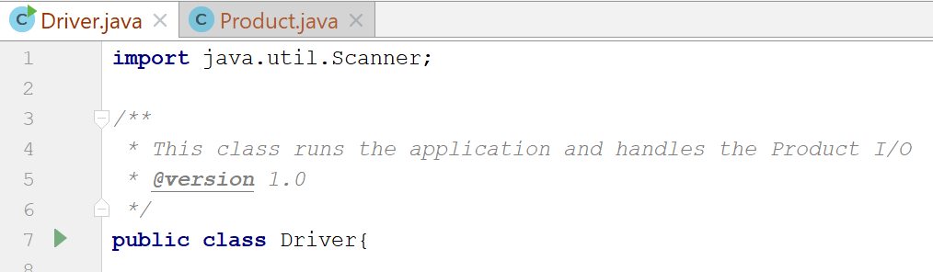
Input in Java: the Scanner Class
In order to use the Scanner class, place the following line as the first line of code in your file (i.e. before class declaration):
      import java.util.Scanner;

Slide 4
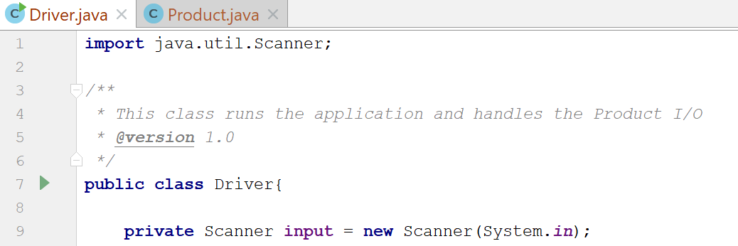
Input in Java: the Scanner Class
Having imported the util package, you will need to write the following instruction in your program.
Scanner input = new Scanner(System.in);

Slide 5
Input in Java: the Scanner Class
This declares a Scanner object called input
(you can name this object anything you wish).
You must have this instruction to be able to call the methods in the Scanner class.

Slide 6
Input in Java: the Scanner Class
Now that a Scanner object is set up, we can use all the input methods
that have been defined in the Scanner class.
There are methods to take in:
ints | .nextInt()
doubles | .nextDouble()
Strings | .nextLine()
chars | .next().charAt(0)
etc… | See API docs for more

Slide 7
Recap: Shop V1.0 - Product
Driver
The Product class stores details about a product:
  name
  code
  unit cost
  in the current product line or not?
Product

Slide 8
Recap: Shop V1.0 - Driver
The Driver class
  has the main() method.
  reads the product details from the user (via the console)
  creates a new Product object.
  prints the product object
  (to the console)
Driver
Product

Slide 9
Shop V1.0 - Driver
Driver
We want to use Scanner to read in
product details from the console.
We will then store these details in a Product object.
And then print these details back to the console.
Product

Slide 10
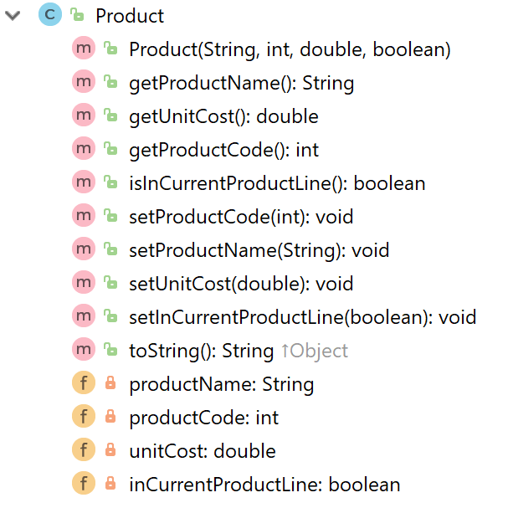
Recap: Shop V1.0: Product
constructor
getters
setters
toString
fields
Notes:
We will use the constructor from Driver to build an object with user input stored in the instance fields.

Slide 11
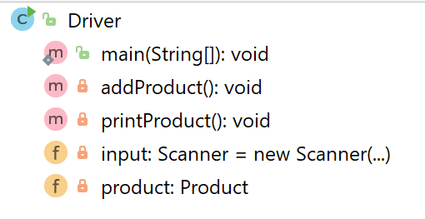
Shop V1.0: Driver class…
main()
methods
fields

Slide 12
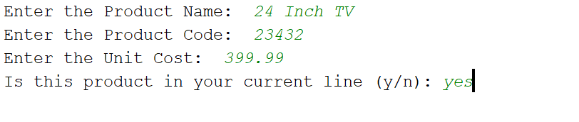
What the program will look like…
Console Output
String
int
double
boolean

Slide 13
public class Driver{
private Scanner input = new Scanner(System.in);
private Product product;
public static void main(String[] args) {
Driver driver = new Driver();
driver.addProduct();
driver.printProduct();
}
//gather the product data from the user and create a new product.
private void addProduct(){
System.out.print("Enter the Product Name: ");
String productName = input.nextLine();
System.out.print("Enter the Product Code: ");
int productCode = input.nextInt();
System.out.print("Enter the Unit Cost: ");
double unitCost = input.nextDouble();
System.out.print("Is this product in your current line (y/n): ");
char currentProduct = input.next().charAt(0);
boolean inCurrentProductLine = false;
if ((currentProduct == 'y') || (currentProduct == 'Y'))
inCurrentProductLine = true;
product = new Product(productName, productCode, unitCost, inCurrentProductLine);
}
//print the product (the toString method is automatically called).
private void printProduct(){
System.out.println(product);
}
}

Slide 14
public class Driver{
private Scanner input = new Scanner(System.in);
private Product product;
public static void main(String[] args) {
Driver driver = new Driver();
driver.addProduct();
driver.printProduct();
}
//gather the product data from the user and create a new product.
private void addProduct(){
System.out.print("Enter the Product Name: ");
String productName = input.nextLine();
System.out.print("Enter the Product Code: ");
int productCode = input.nextInt();
System.out.print("Enter the Unit Cost: ");
double unitCost = input.nextDouble();
System.out.print("Is this product in your current line (y/n): ");
char currentProduct = input.next().charAt(0);
boolean inCurrentProductLine = false;
if ((currentProduct == 'y') || (currentProduct == 'Y'))
inCurrentProductLine = true;
product = new Product(productName, productCode, unitCost, inCurrentProductLine);
}
//print the product (the toString method is automatically called).
private void printProduct(){
System.out.println(product);
}
}

Slide 15
public class Driver{
private Scanner input = new Scanner(System.in);
private Product product;
public static void main(String[] args) {
Driver driver = new Driver();
driver.addProduct();
driver.printProduct();
}
//gather the product data from the user and create a new product.
private void addProduct(){
System.out.print("Enter the Product Name: ");
String productName = input.nextLine();
System.out.print("Enter the Product Code: ");
int productCode = input.nextInt();
System.out.print("Enter the Unit Cost: ");
double unitCost = input.nextDouble();
System.out.print("Is this product in your current line (y/n): ");
char currentProduct = input.next().charAt(0);
boolean inCurrentProductLine = false;
if ((currentProduct == 'y') || (currentProduct == 'Y'))
inCurrentProductLine = true;
product = new Product(productName, productCode, unitCost, inCurrentProductLine);
}
//print the product (the toString method is automatically called).
private void printProduct(){
System.out.println(product);
}
}

Slide 16
The addProduct() console output…
Console Output
String
int
double
boolean
Now, Let’s Look at how this is done…

Slide 17
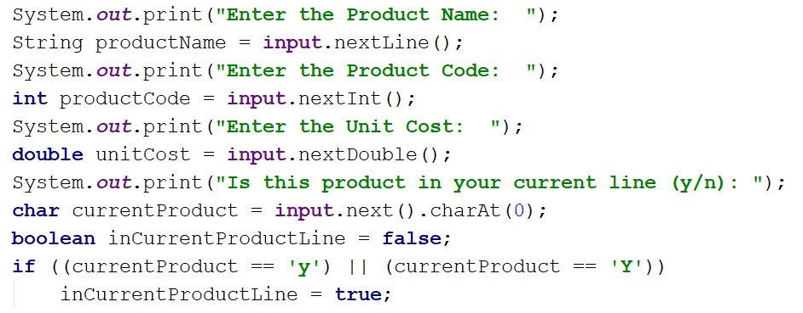
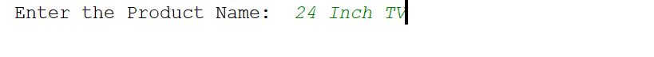
ShopV1.0 – read Product Name (String)
Console Output

Slide 18
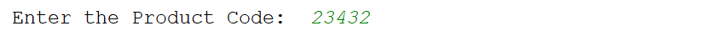
ShopV1.0 – read Product Code (int)
Console Output

Slide 19
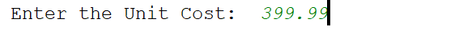
ShopV1.0 – read Unit Cost (double)
Console Output

Slide 20
ShopV1.0 – In Current Product Line? (boolean)
For booleans, take in a character first, then test it
Console Output

Slide 21
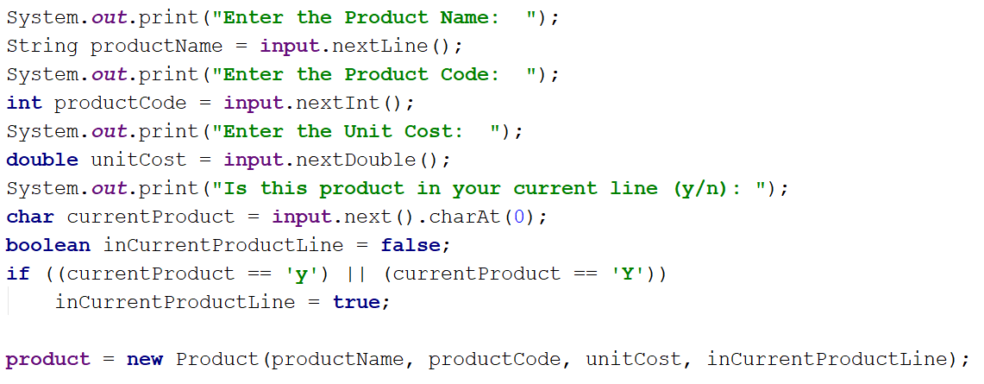
ShopV1.0 – Create Product Object
Using the values taken in
pass them to the Product constructor

Slide 22
public class Driver{
private Scanner input = new Scanner(System.in);
private Product product;
public static void main(String[] args) {
Driver c = new Driver();
c.addProduct();
c.printProduct();
}
//gather the product data from the user and create a new product.
private void addProduct(){
System.out.print("Enter the Product Name: ");
String productName = input.nextLine();
System.out.print("Enter the Product Code: ");
int productCode = input.nextInt();
System.out.print("Enter the Unit Cost: ");
double unitCost = input.nextDouble();
System.out.print("Is this product in your current line (y/n): ");
char currentProduct = input.next().charAt(0);
boolean inCurrentProductLine = false;
if ((currentProduct == 'y') || (currentProduct == 'Y'))
inCurrentProductLine = true;
product = new Product(productName, productCode, unitCost, inCurrentProductLine);
}
//print the product (the toString method is automatically called).
private void printProduct(){
System.out.println(product);
}
}

Slide 23

Questions?

